Slide 1
Functions
CSCI 1380 Introduction to Programming in Python

Slide 2
Functions
Function: group of statements within a program that perform as specific task
Usually one task of a large program
Functions can be executed in order to perform overall program task
Known as divide and conquer approach
Modularized program: program wherein each task within the program is in its own function

Slide 3
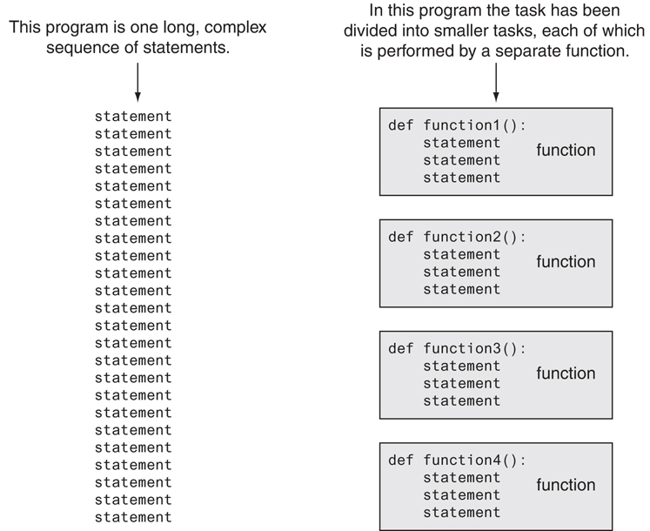
Divide & conquer

Slide 4
Benefits of using functions
The benefits of using functions include:
Simpler code
Code reuse
Write the code once and call it multiple times
Better testing & debugging
Can test and debug each function (find out what’s wrong)
Faster development
Easier facilitation of teamwork
Different team members can write different functions.

Slide 5
Defining a function
Function name should be descriptive of the task carried out by the function.
Often includes a verb
Function definition: specifies what function does
Function header: first line of function
Includes keyword def and function name, followed by parenthesis and colon.
Block: set of statements that belong together as group.
def function_name():
statement
statement
...

Slide 6
Calling a function
Call a function to execute it.
When a function is called:
Interpreter jumps to the function and executes statements in the block.
Interpreter jumps back to part of program that called the function.
Known as function return
def function_name():
statement
statement
...
function_name() # call

Slide 7
Local variables
Local variable: variable that is assigned a value inside a function.
Belongs to the function in which it was created
Only statements inside that function can access it, error will occur if another function tries to access the variable
Scope: the part of a program in which a variable may be accessed.
For local variable: function in which created
def function_A():
x = 10
def function_B():
print( x )# ERROR!
print( x )# ERROR!

Slide 8
Void function & value-Returning functions
A void function:
Simply executes the statements it contains and then terminates.
A value-returning function:
Executes the statements it contains, and then it returns a value back to the statement that called it.
The input, int, and float functions are examples of value-returning functions.
def func_void():
print( “Hello!” )
def func_return():
return 10

Slide 9
Function parameters & arguments
Parameter variable: variable that is assigned the value of an argument when the function is called
The parameter and the argument reference the same value
General format:
def function_name( parameter ):
Scope of a parameter: the function in which the parameter is used

Slide 10
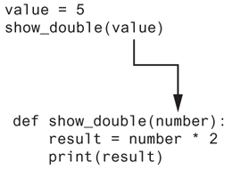
Passing arguments to functions

Slide 11
Passing multiple arguments
Python allows writing a function that accepts multiple arguments
Parameter list replaces single parameter
Parameter list items separated by comma
Arguments are passed by position to corresponding parameters
First parameter receives value of first argument, second parameter receives value of second argument, etc.

Slide 12
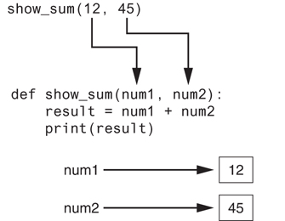
Passing multiple arguments

